Slide 1
SCS3253010 Machine Learning Project
Jianhong Zhang; Stephen Ho; David Wang; Kewei Chen

Slide 2
Overview
Data: Breast Cancer data base from UCI Machine Learning Data Repository.
Purpose: Utilize Machine Learning techniques to help diagnose Breast Cancer
Project Roadmap:
Data Preparation and Exploratory Data Analysis
Apply Classification and plot ROC
Feature Selection
Create Confusion Matrix using testing Dataset
Apply PCA analysis
Visualize high-dimension datasets using t-SNE
Create and train Neutral Network (Keras)
Conclusion

Slide 3
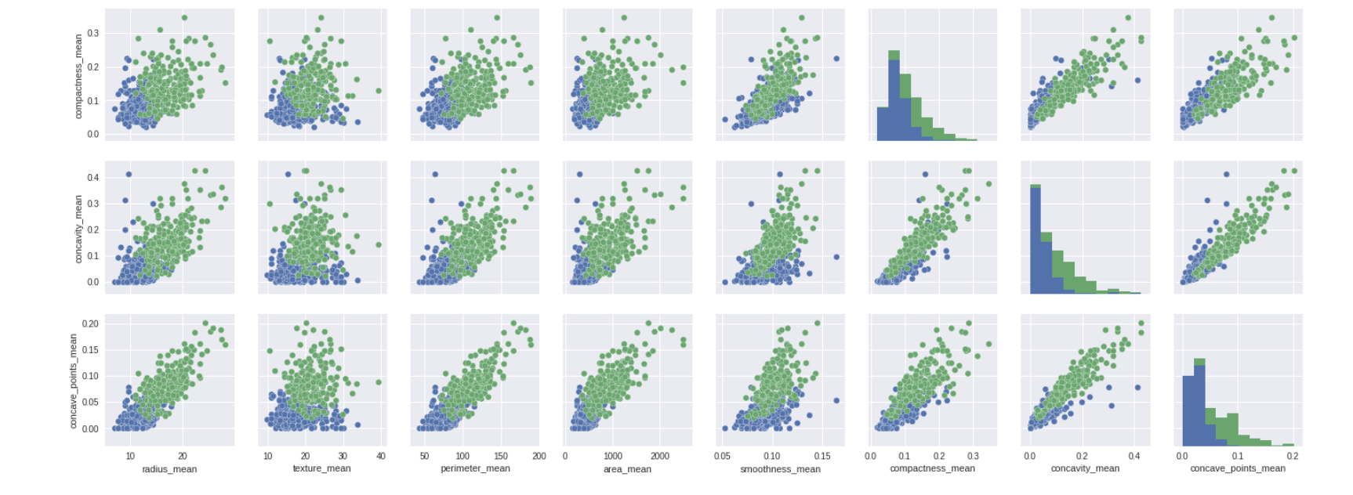
Data Preparation and EDA
Initial data scanning to understand the structure
Basic statistical check to spot any potential data issue
Add the necessary data columns and created a Dataframe
Chang the categorical name (M/B) to categorical code (1/0)
Use Seaborn Charts to scan through the relationships between these data features as well as their relationship to categorical results (diagnosis results)

Slide 4
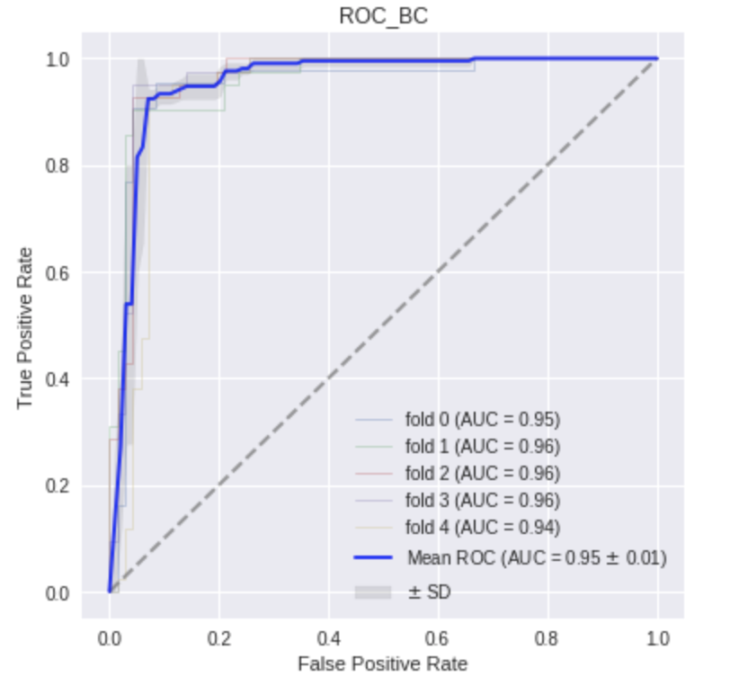
Classification and ROC
After testing various Classification Tools using KNN, SVM, Random Forest, Logistic Regression, SVM is proven to produces better results.
Apply 5 fold cross valuation to find the best hyper-parameters for SVM.
Another technique we employed is adding noise.
Adding noise expands the size of the training dataset.
Each time a training sample is exposed to the model, random noise is added to the input variables making them different every time when it's exposed to the model.
This makes the training process more robust and reduce generalization error.

Slide 5
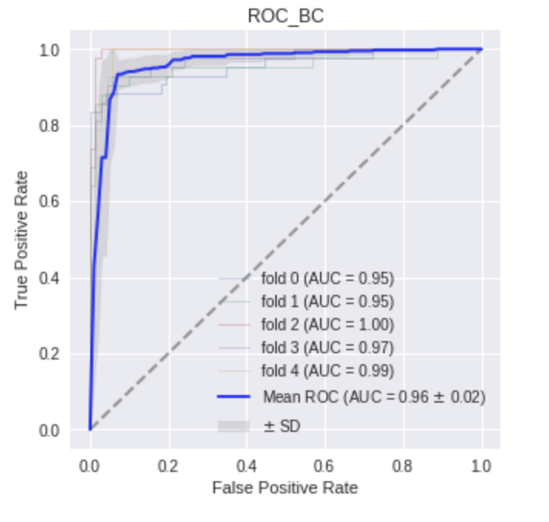
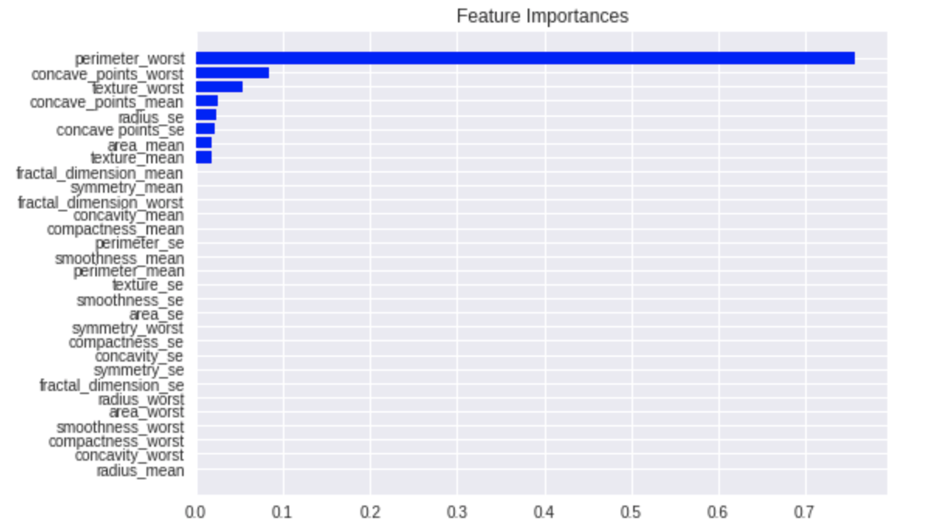
Feature Selection
This ranks the importance of each feature using Decision Tree Regressor.
We found 'perimeter_worst' feature is the most important one. This feature is the mean of the three largest tumor perimeter values. The statistical significance of tumor increases with the size of the tumor.
ROC using only the selected important features for training. Comparing the result with the previous one, it shows just a marginal improvement.

Slide 6
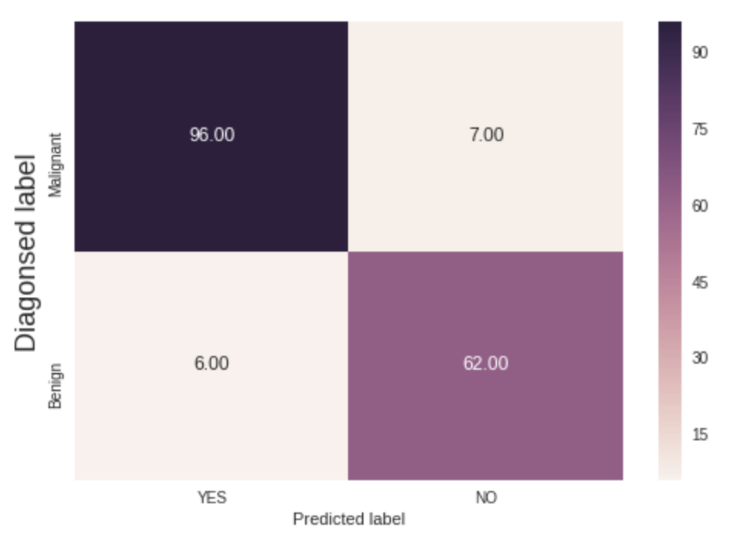
Confusion Matrix (Testing Dataset)
This provides an alternative view of the accuracy of the current classification model under the testing dataset

Slide 7
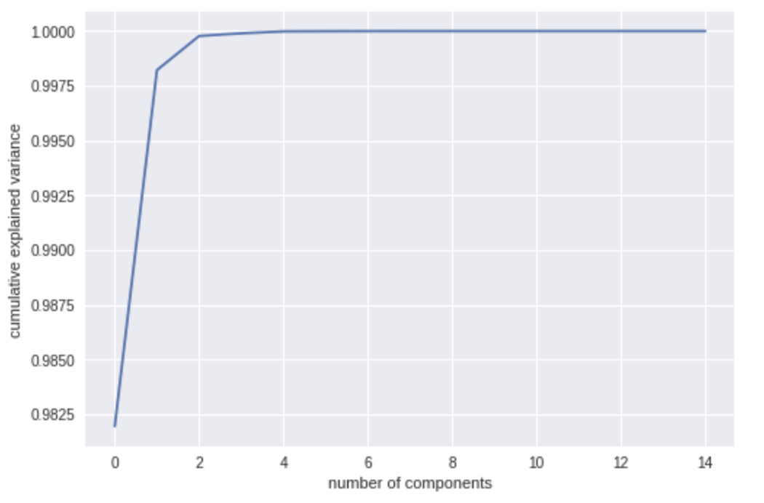
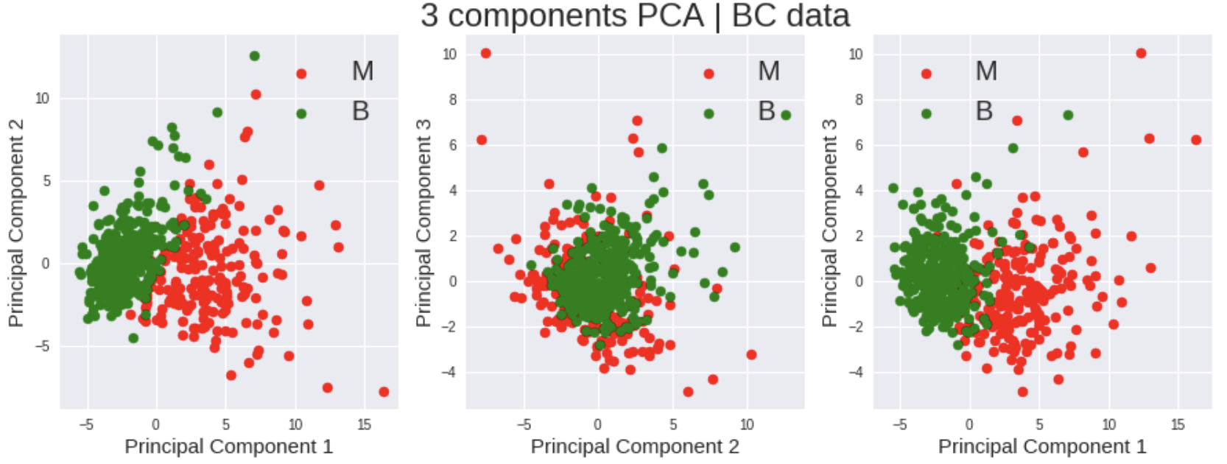
PCA
Apply PCA and create a new Dataframe.
Use SGD classifier on the newly created Dataframe.
Gridsearch is used to find the best hyper-parameters that explain the training dataset. (including the ideal number of PCA components)
Explore the top 3 principle components.

Slide 8
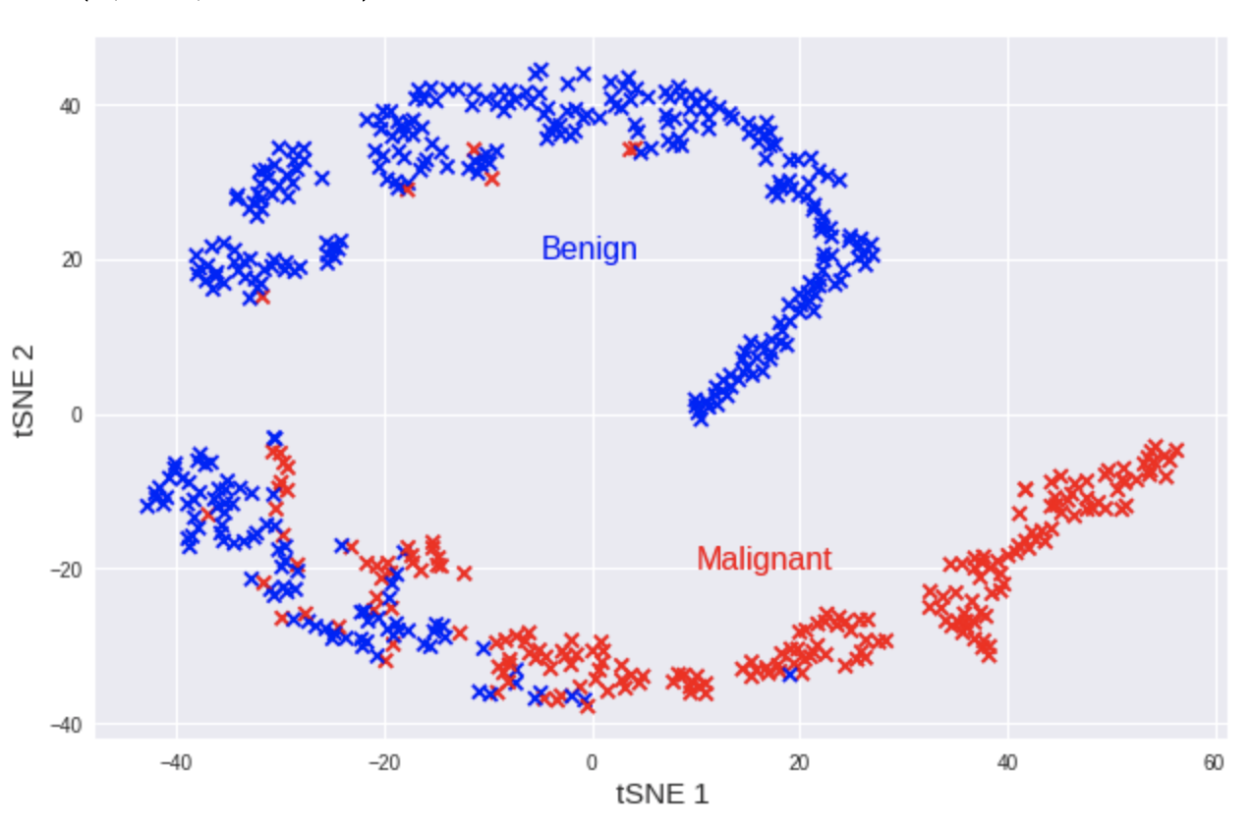
t-SNE
Employ t-SNE technique to see how it can visually cluster the data.
t-SNE takes the high dimensional dataset and reduces it to low dimensional graph but retains a lot of the original information.

Slide 9
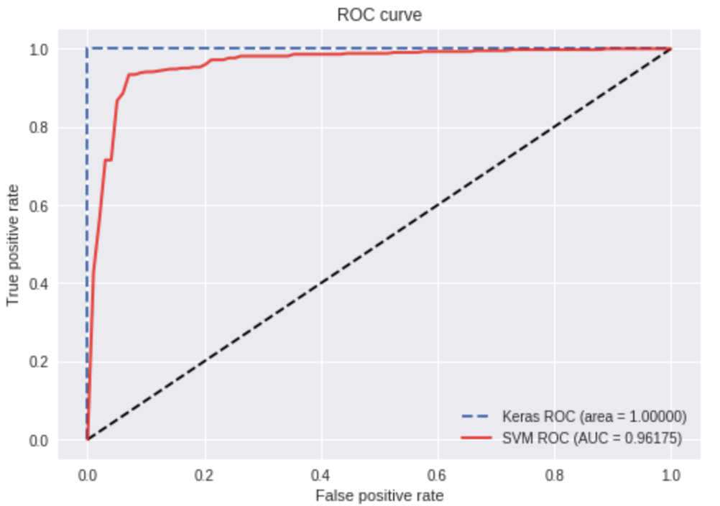
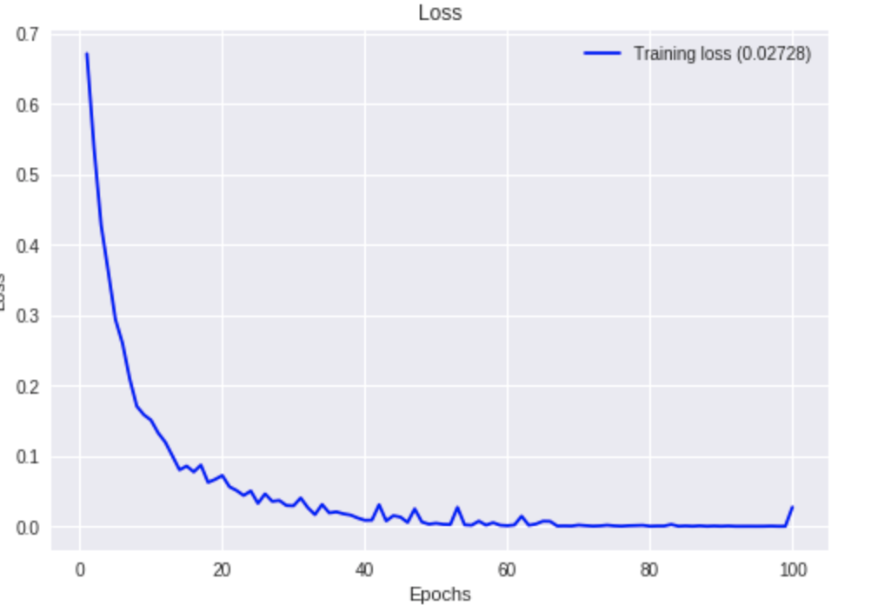
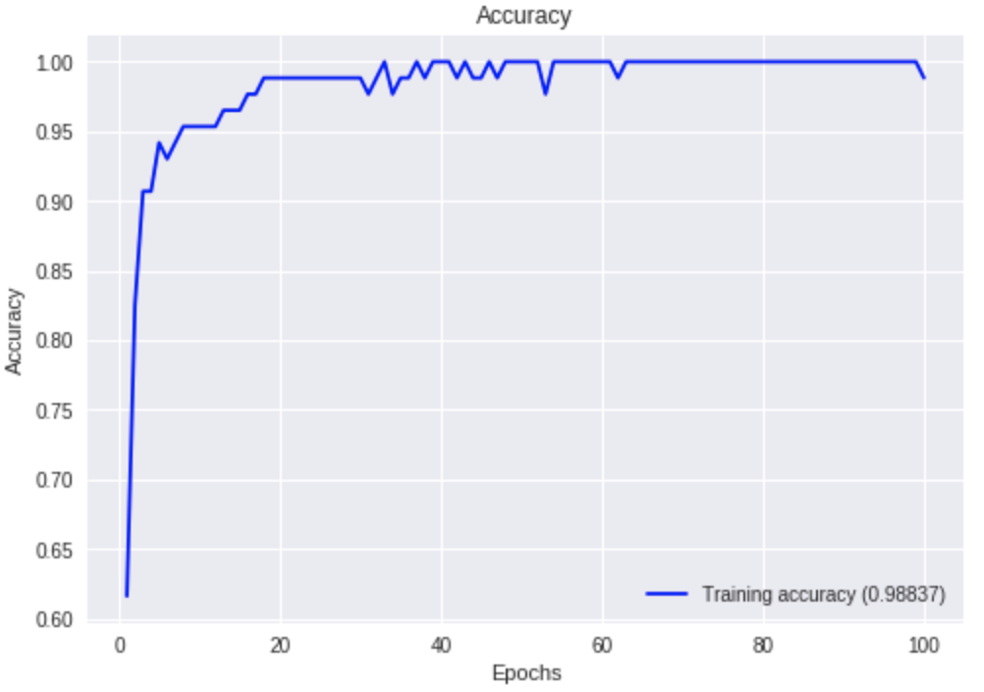
Neural Network
Create a plotting function that can plot the loss/accuracy against the number of epochs on the training and validation dataset. This works similar as tensor board.
Created a Sequential NN with 5 layers (input/output + 3 hidden layers). Another feature we added is 'dropout' which can help adjust weights to avoid over fitting and reduce running time.
Compare the Keras prediction results with the SVM result under ROC. It shows the Keras result is slightly better.

Slide 10
Conclusion
The size of the tumor is the most important deterministic factor to conclude whether the tumor is Malignant or Benign.
Both Keras and SVM have been performing well to predict the results (with Keras being slightly better)
In this exercise, we found adding noise generally helps the training process.
This dataset only has 568 samples, a larger amount of samples could help with better prediction results. This classification technique (either neural network or scikitlearn) can be employed to analyze the tumor once standard data collection, cleaning pipeline is established.

Slide 11
Reference
Disclaimer - Data Source:
Creators:
1. Dr. William H. Wolberg, General Surgery Dept.
University of Wisconsin, Clinical Sciences Center
Madison, WI 53792
wolberg '@' eagle.surgery.wisc.edu
2. W. Nick Street, Computer Sciences Dept.
University of Wisconsin, 1210 West Dayton St., Madison, WI 53706
street '@' cs.wisc.edu 608-262-6619
3. Olvi L. Mangasarian, Computer Sciences Dept.
University of Wisconsin, 1210 West Dayton St., Madison, WI 53706
olvi '@' cs.wisc.edu
Donor:
Nick Street
Project link on Github: https://github.com/scs32532019/ML_FinalProject_BreastCancer

Slide 12
Thank you
Any Questions?

